Slide 1
Weekly meeting
12 24 2024
Ty Bottorff

Slide 2
Outline
CD127 manuscript analysis progress

Slide 3
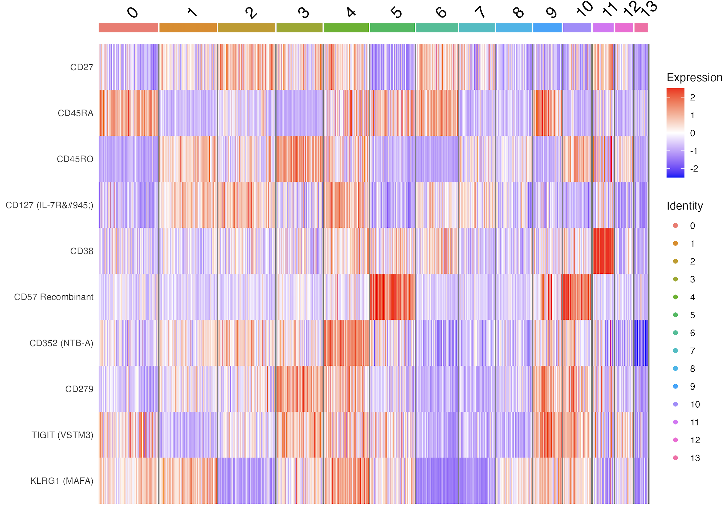
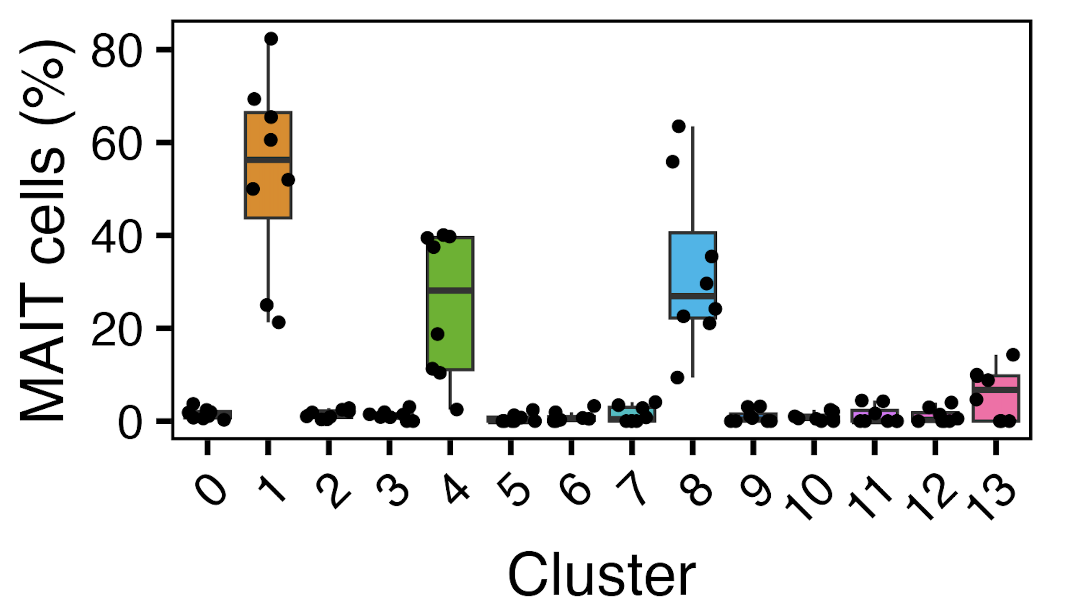
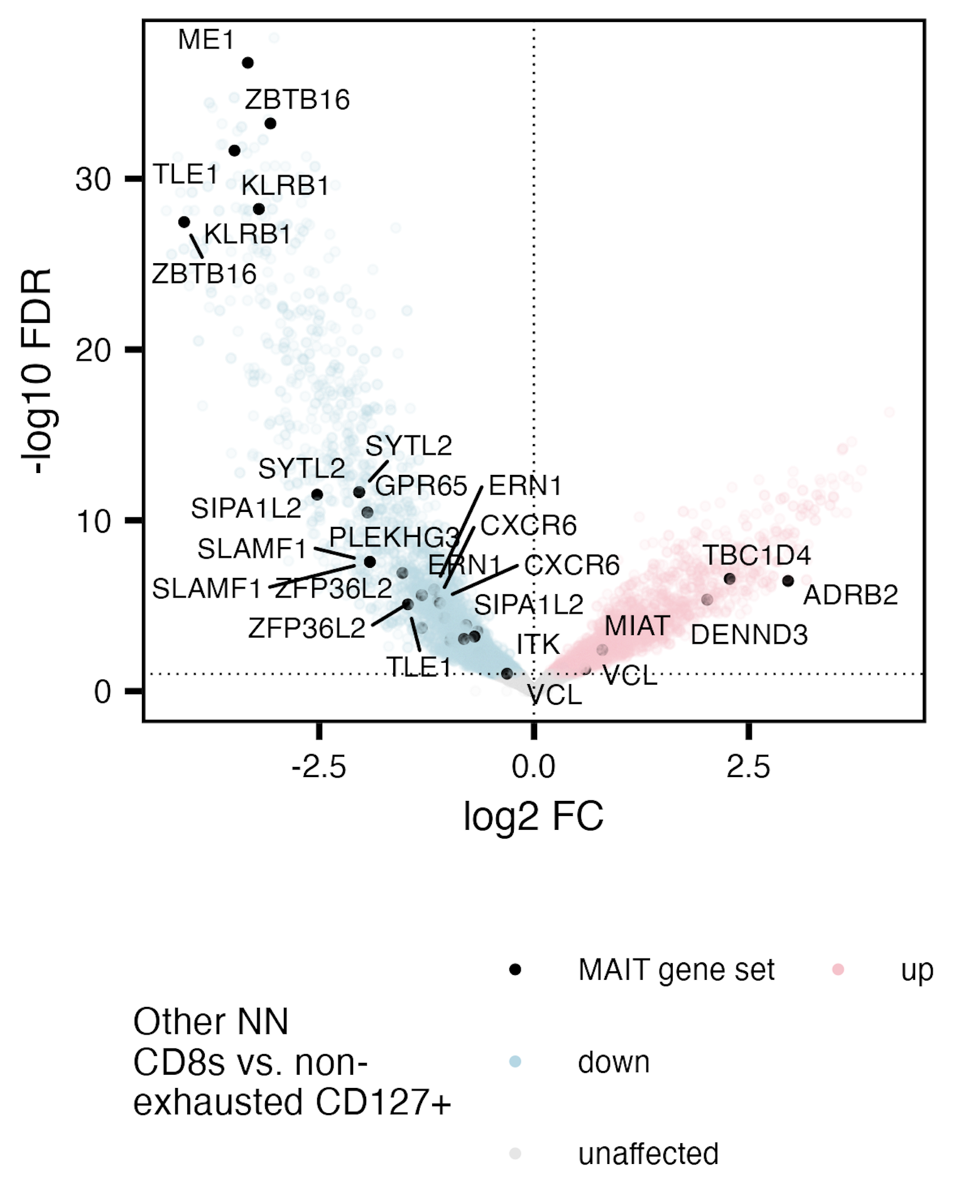
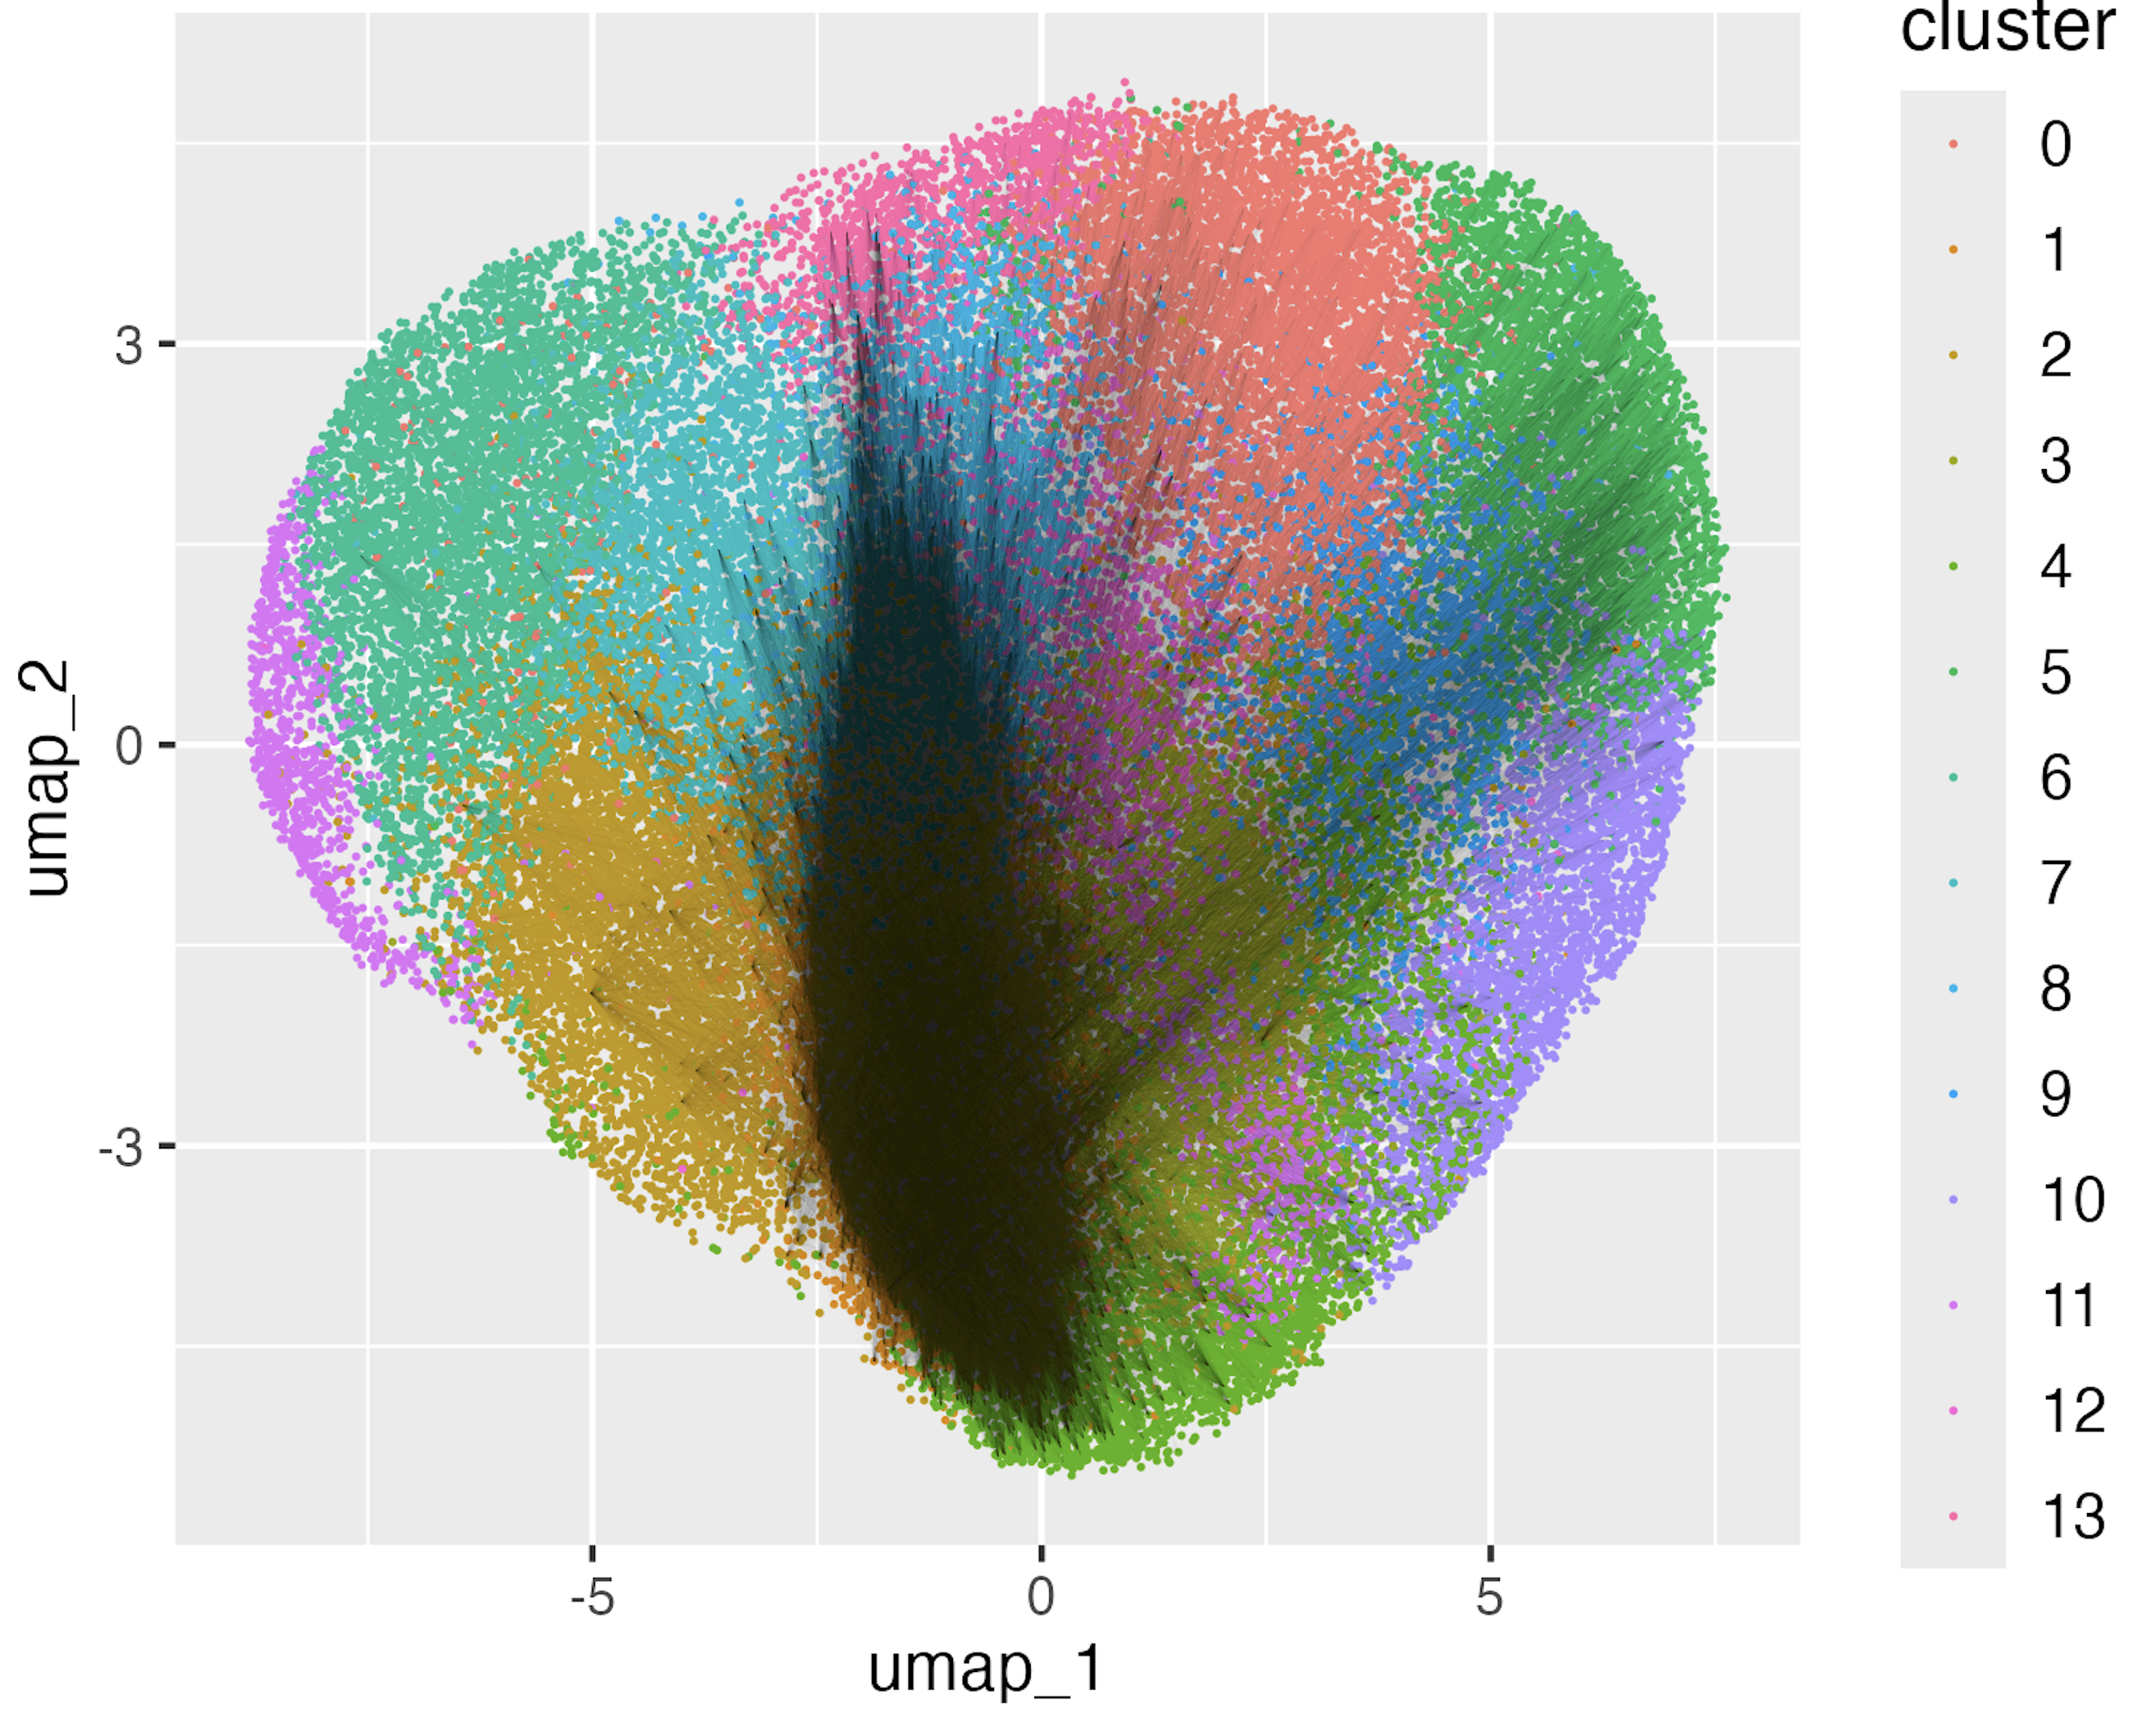
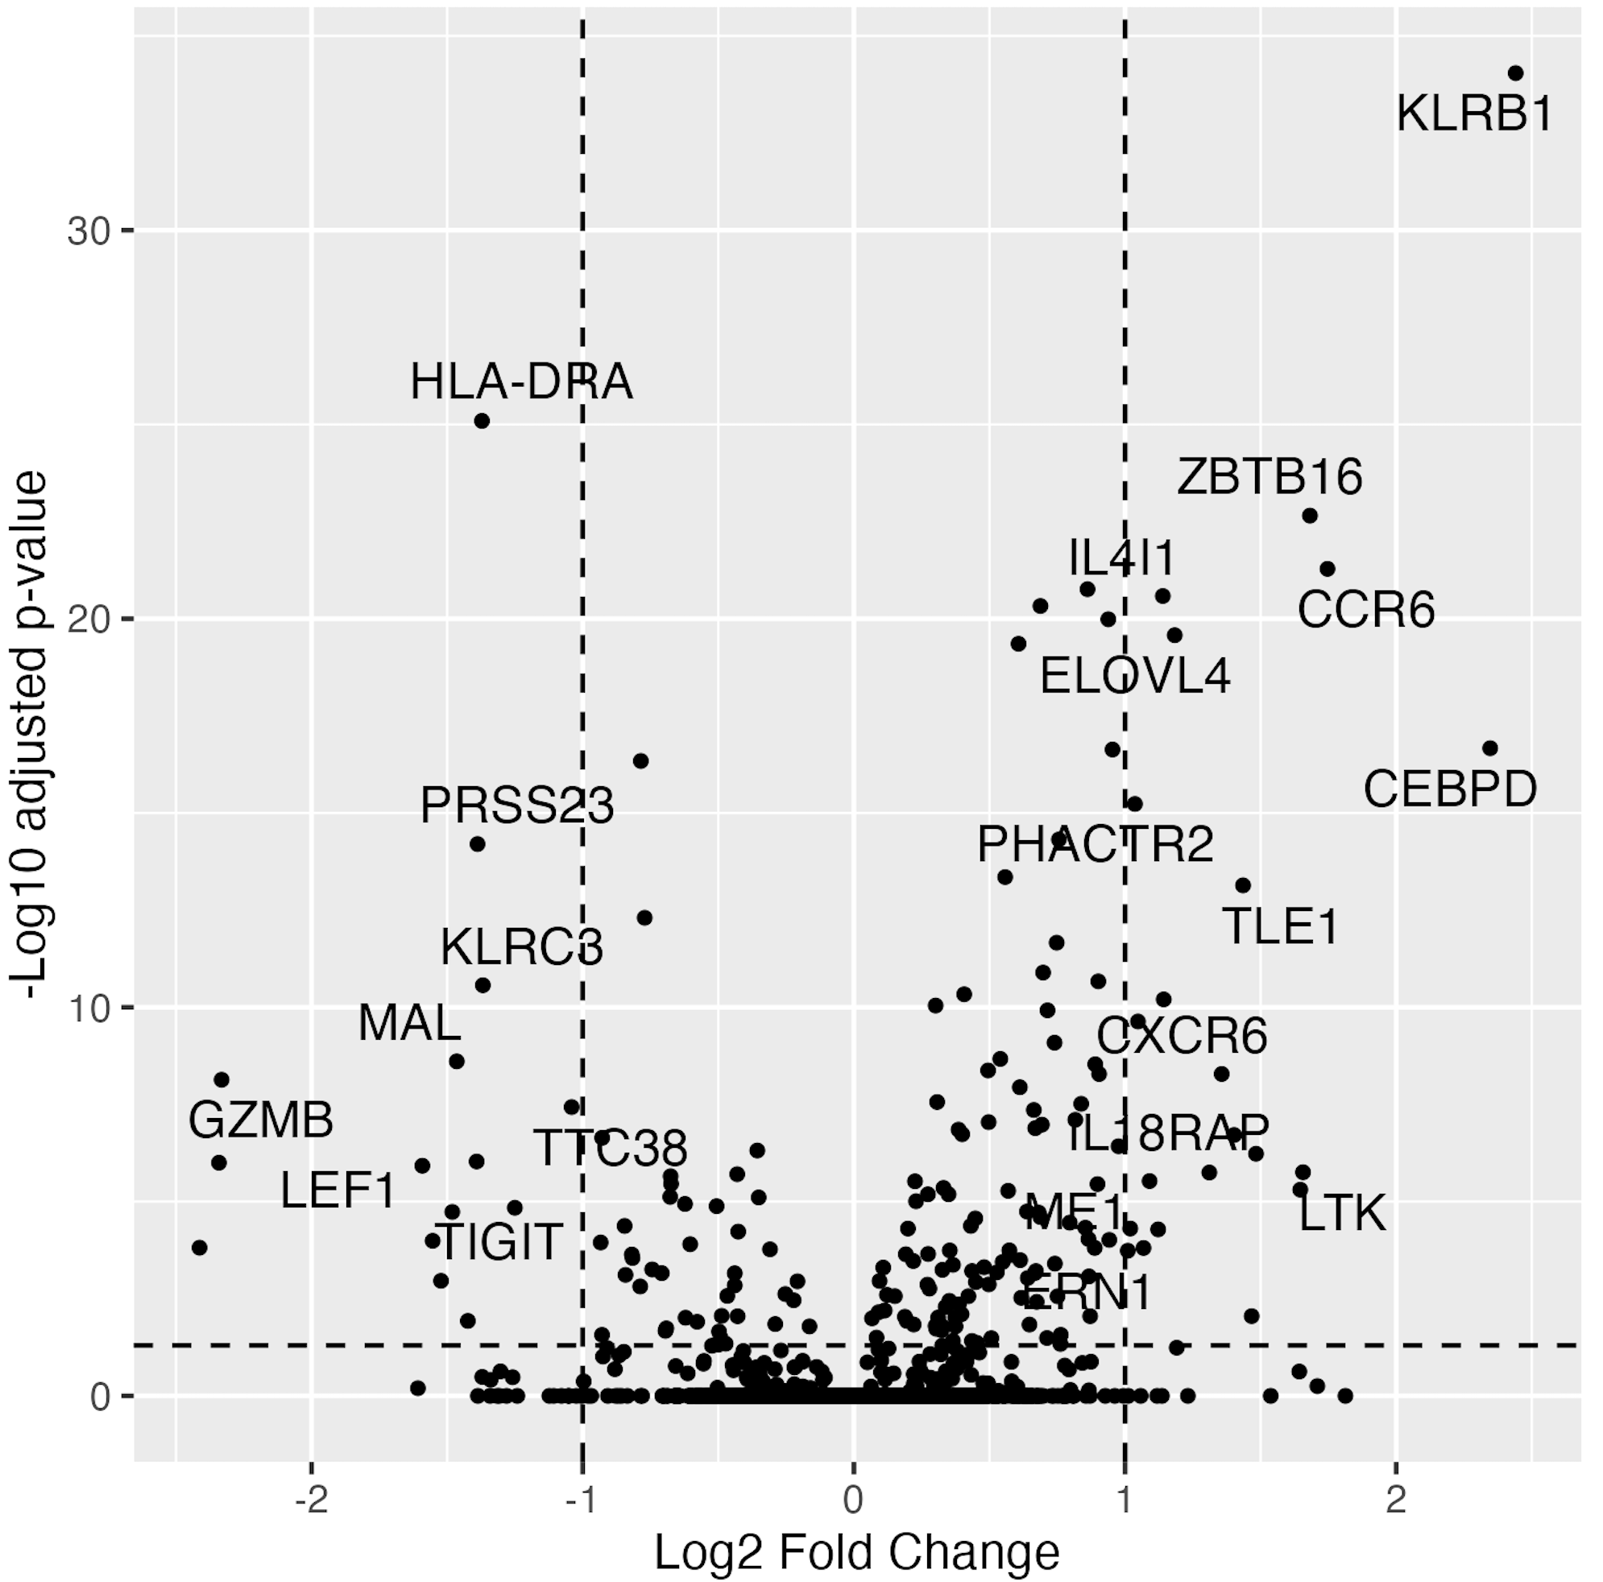
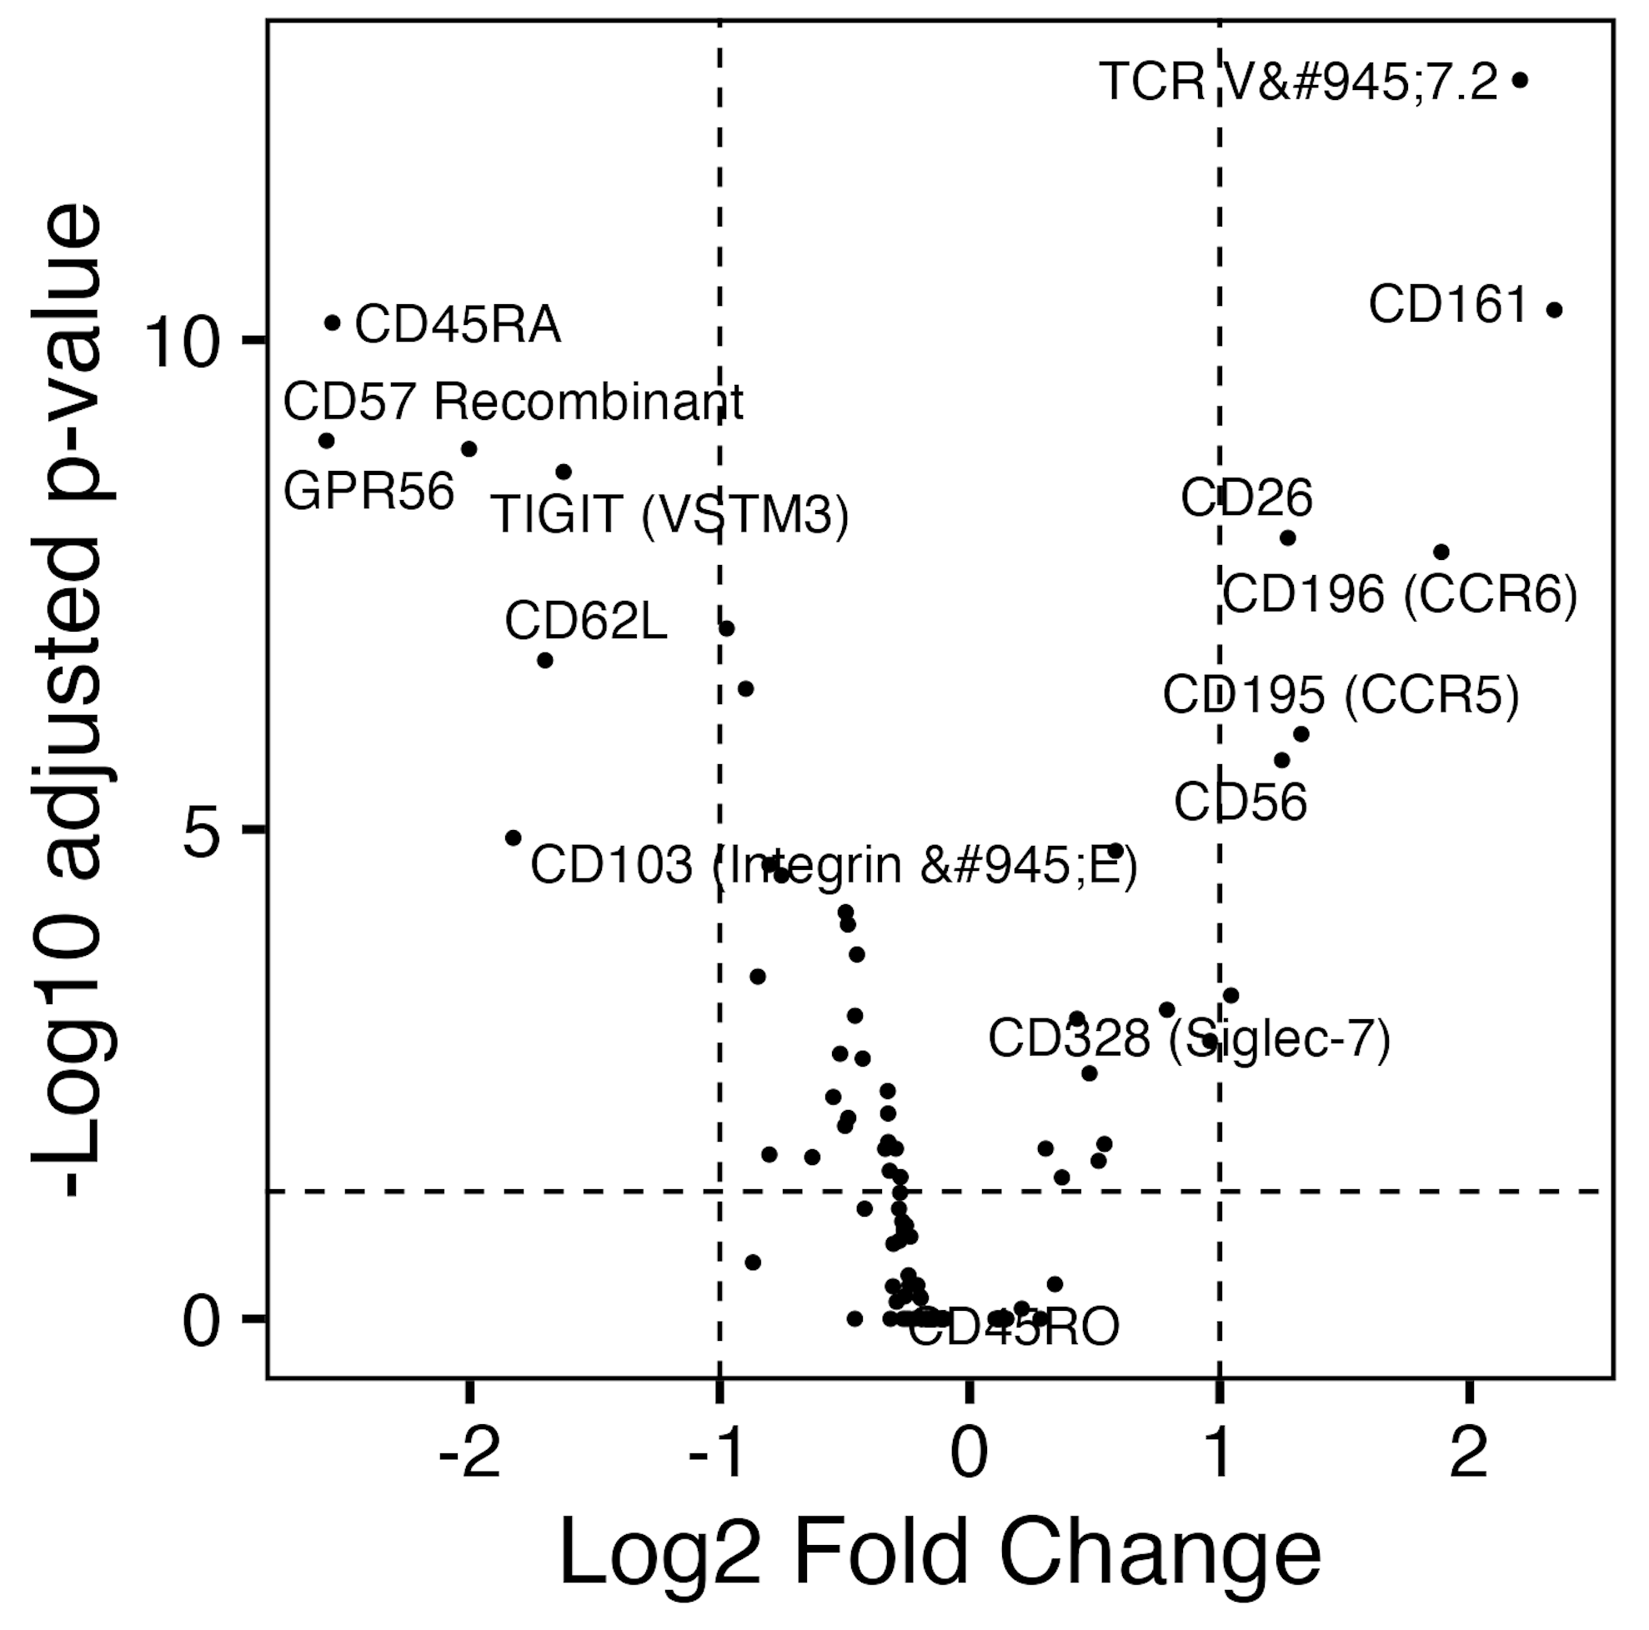
NR-associated TIGIT⁻KLRG1⁺ CD127⁺ CD8s resemble MAITs
A
C
F
D
B
E: Jaccard similarity heatmap

Slide 4
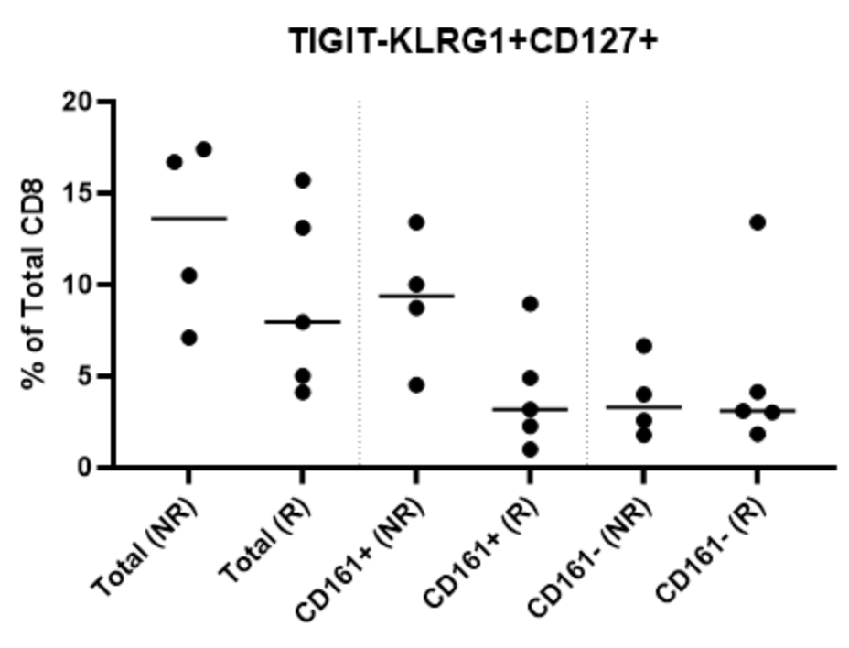
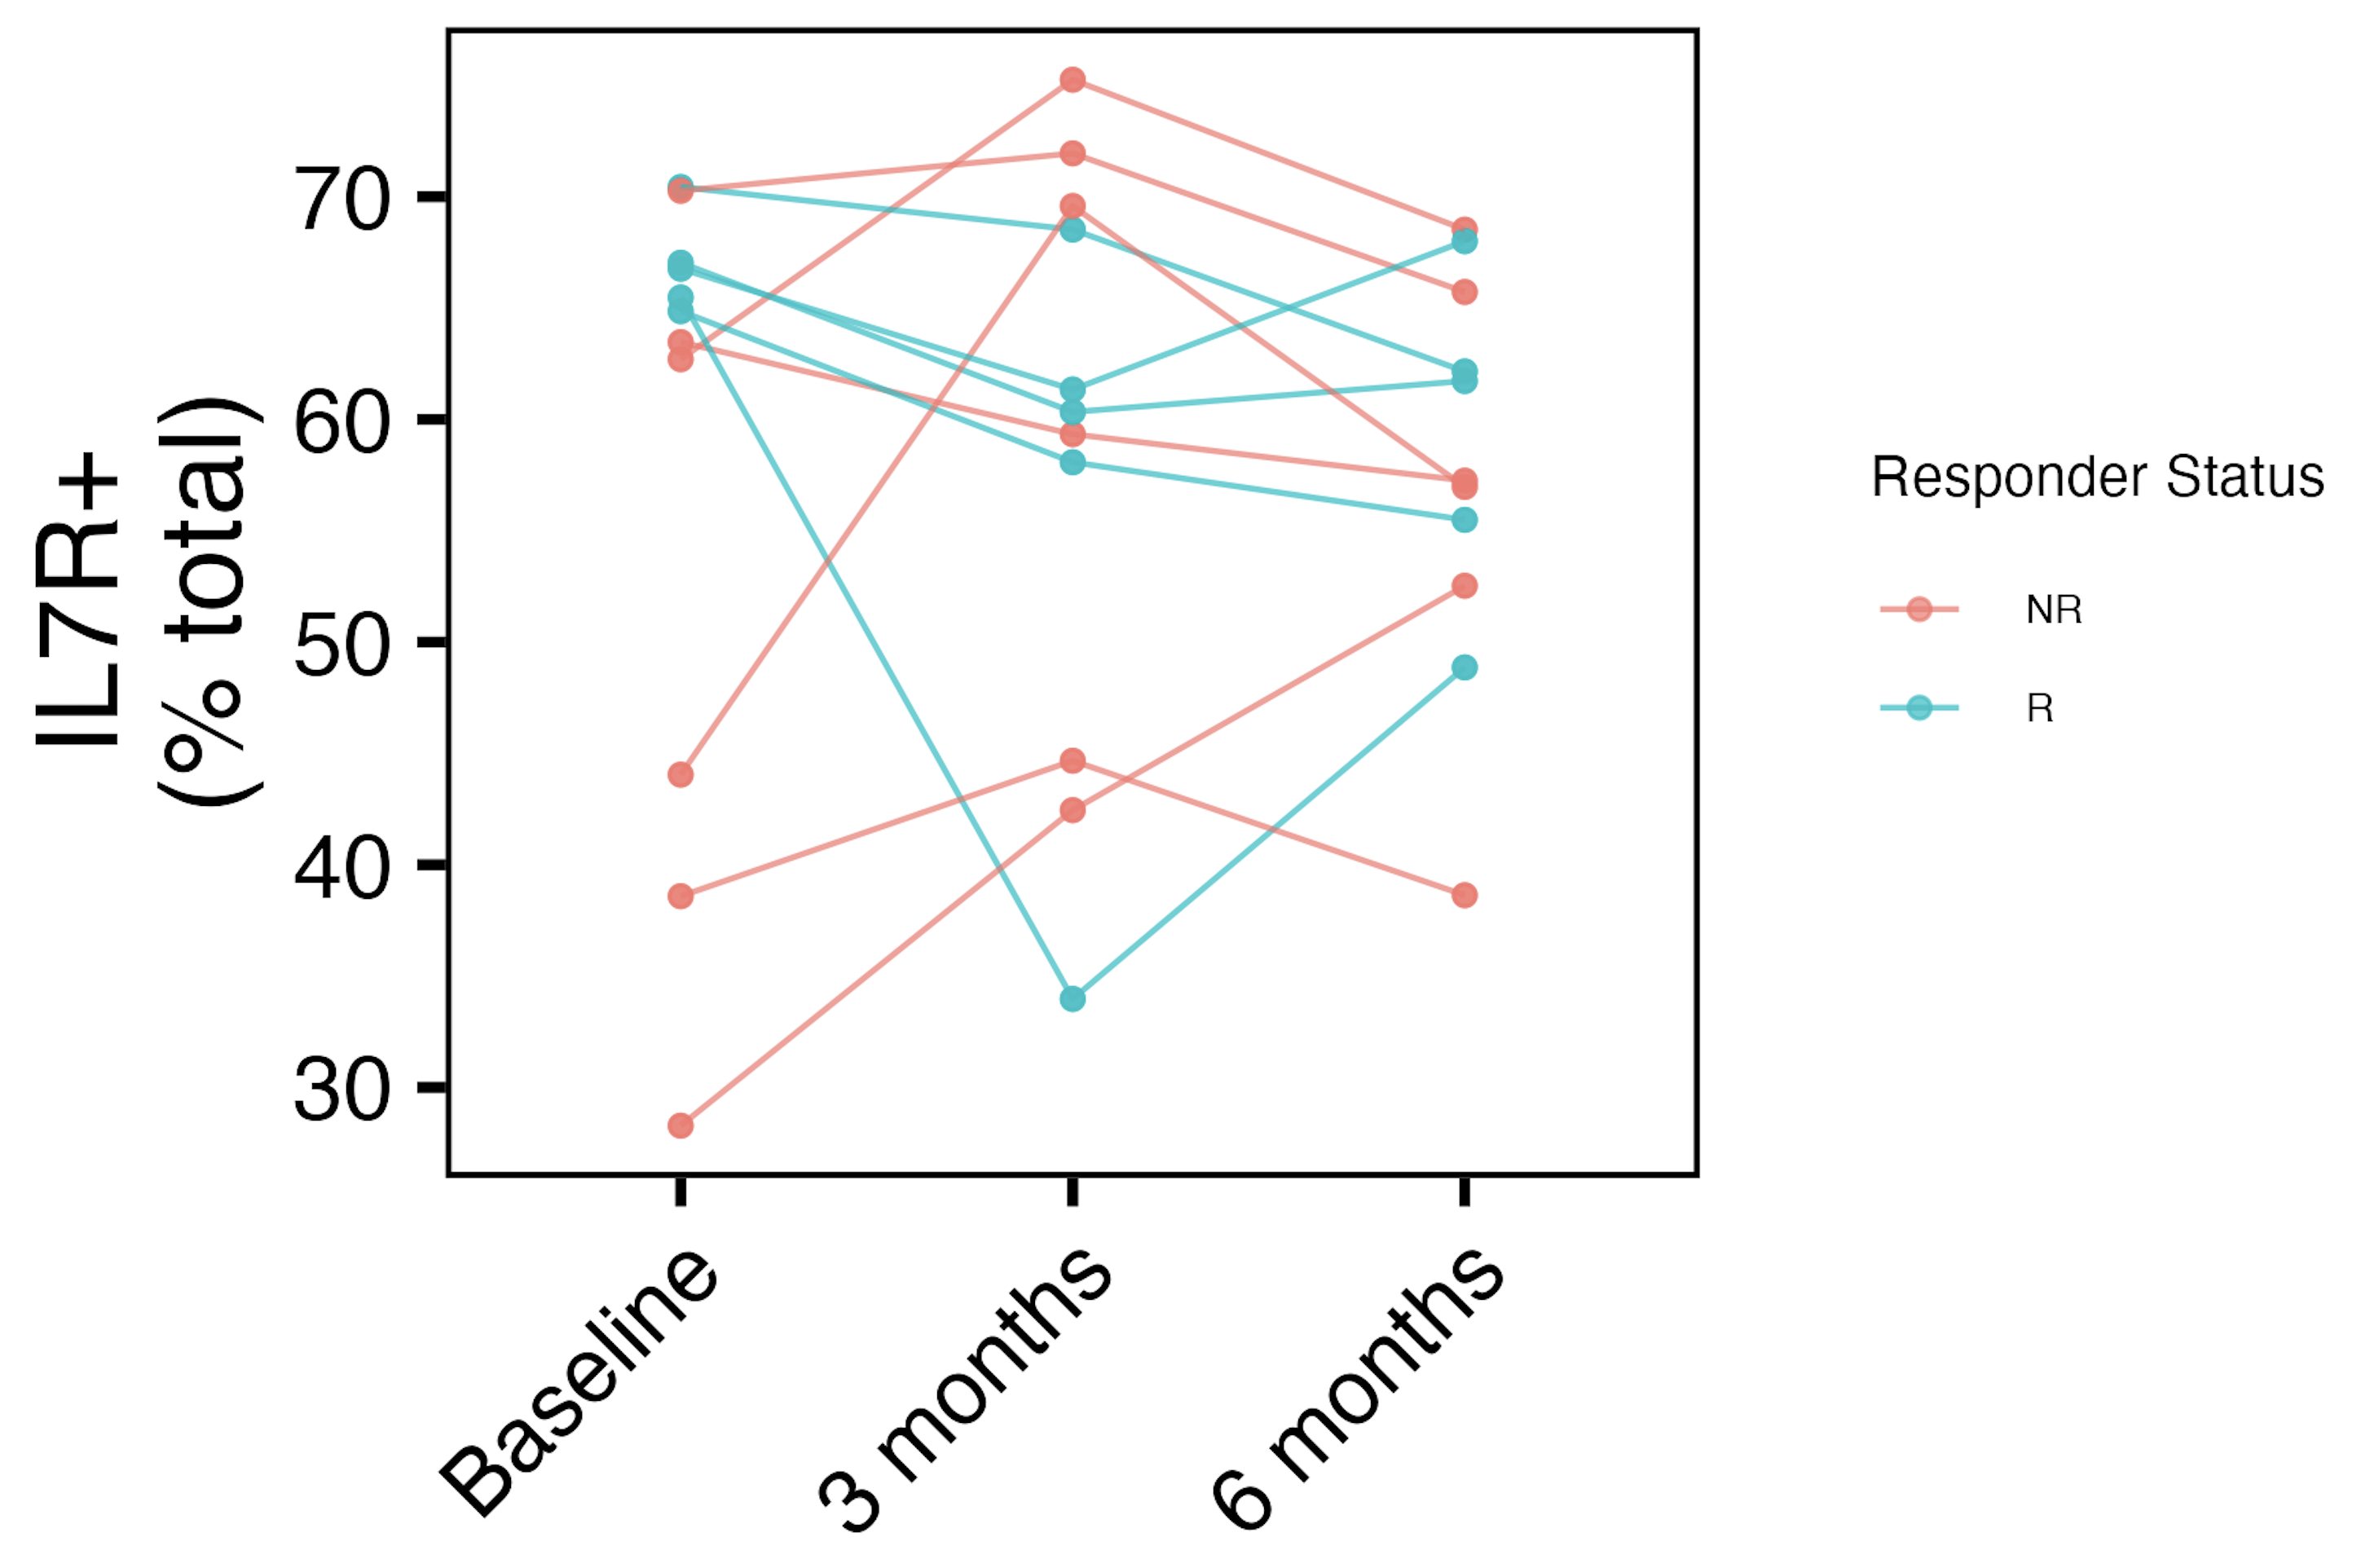
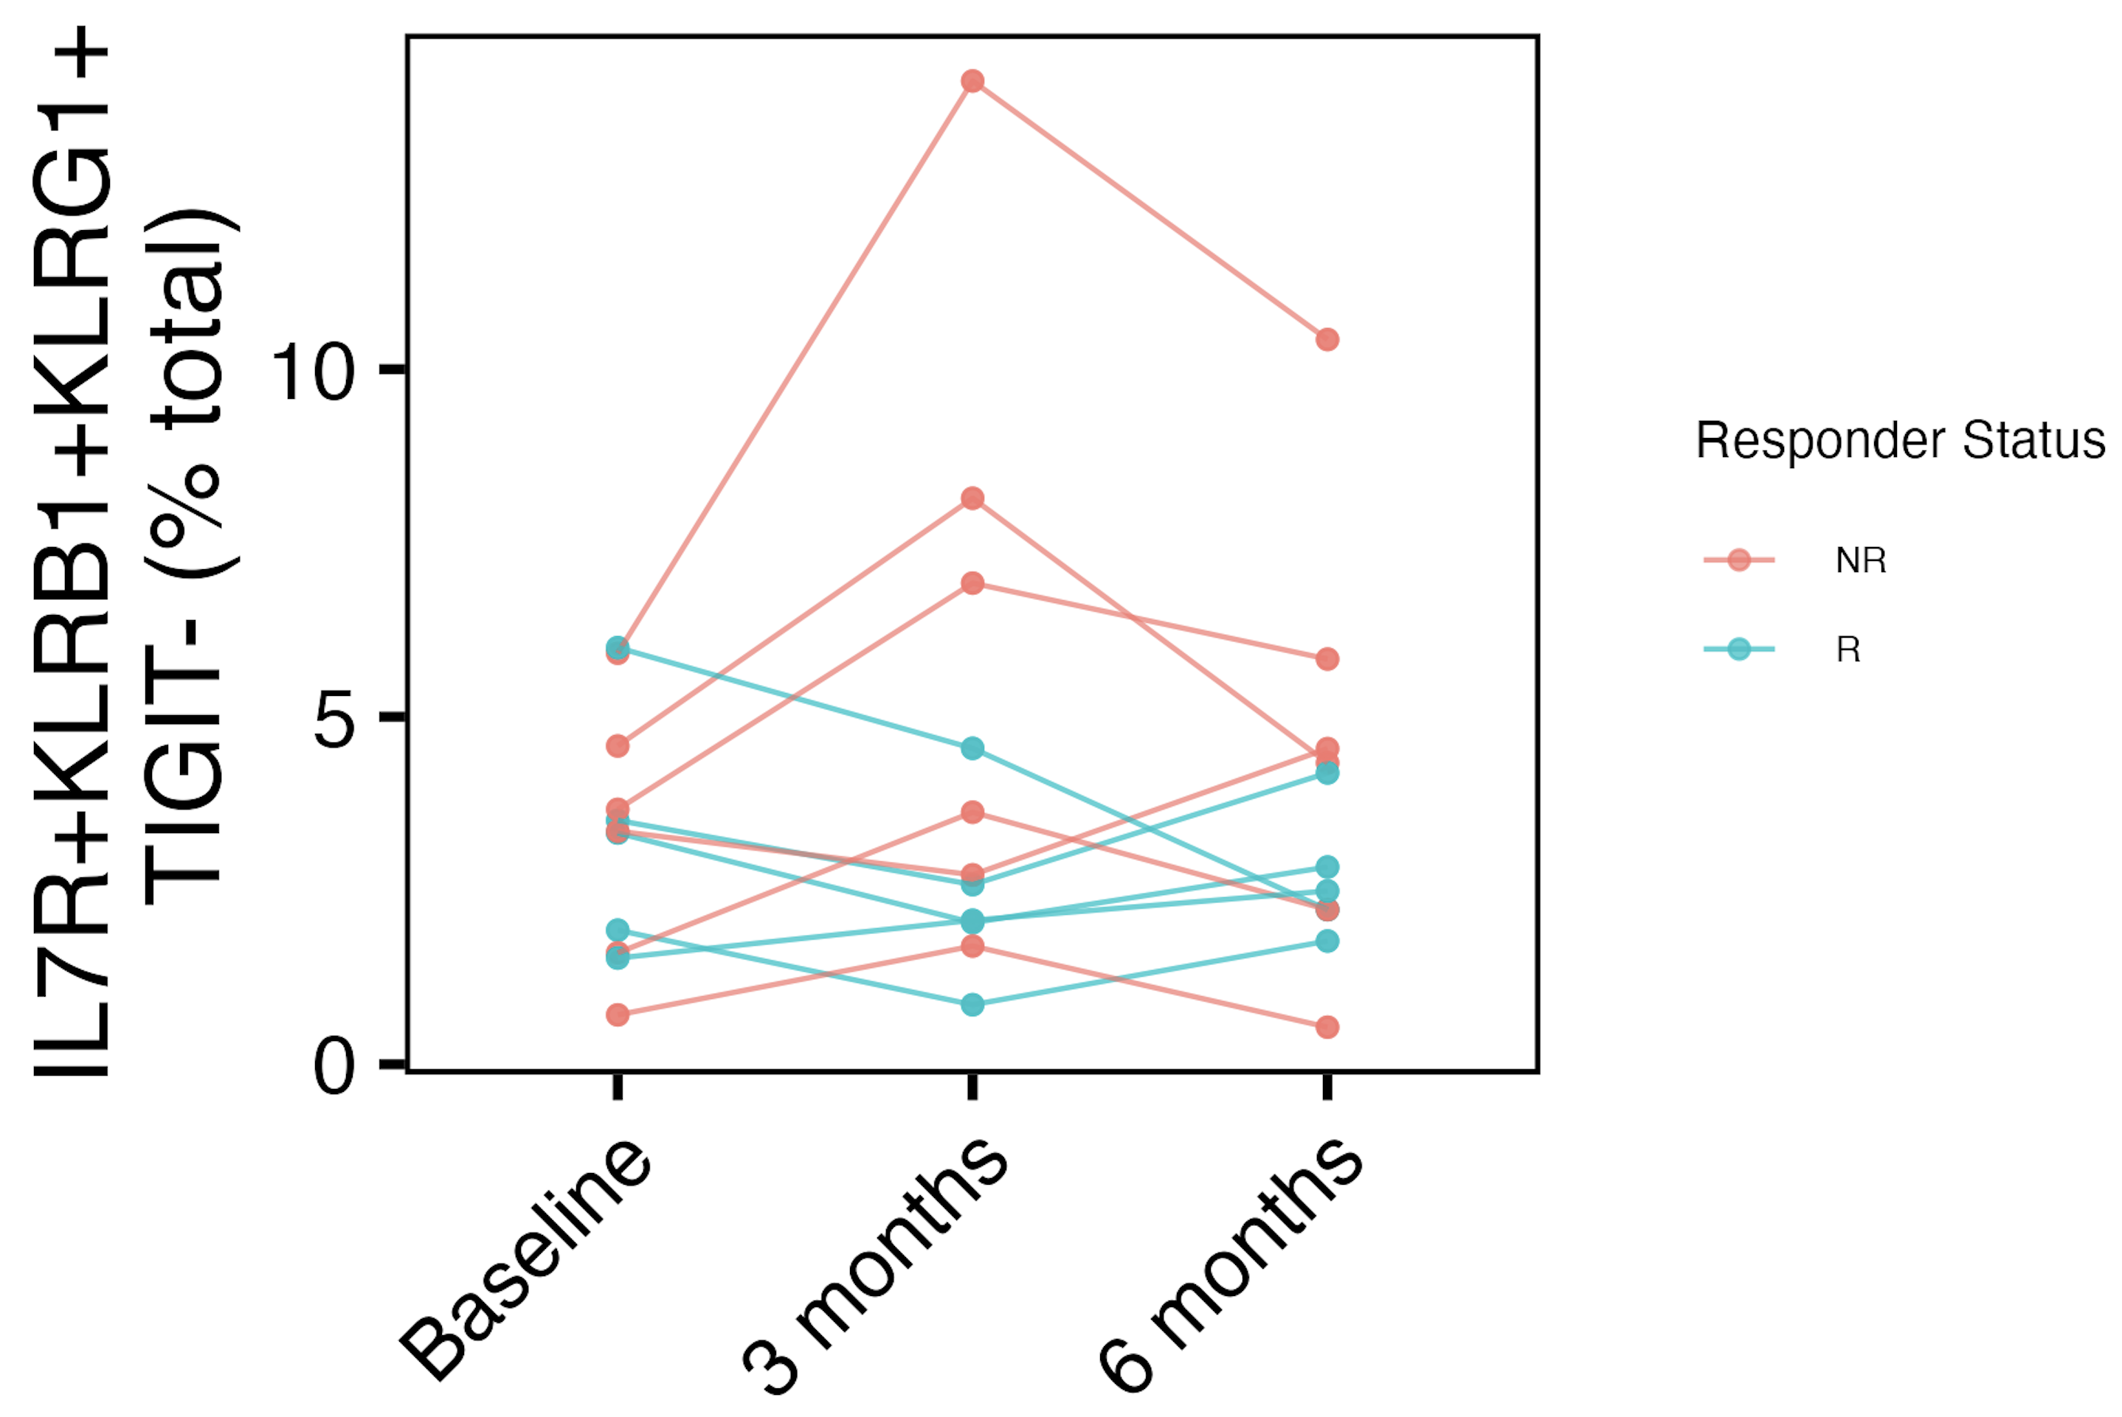
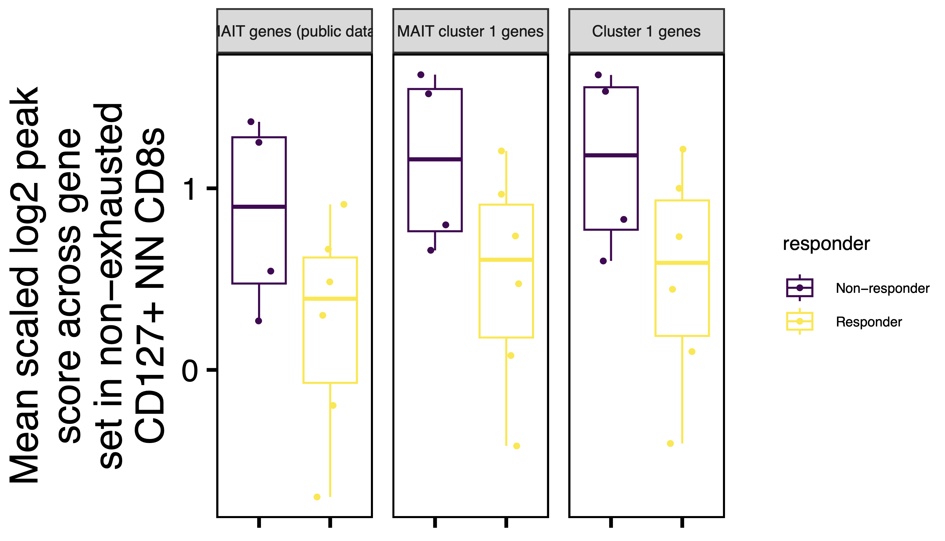
CD127⁺ (MAIT?) signature elevated in NR to teplizumab
TN10 P348-2
AbATE

Slide 5
Conclusions
In T1D/HC, population of TIGIT⁻KLRG1⁺CD127⁺ CD8s enriched for MAITs/resemble MAITs
In AbATE
TIGIT⁻KLRG1⁺CD127⁺CD161⁺ frequency higher in NR than R
Weakly higher accessibility of MAIT genes in non-exhausted CD127⁺ in NR than R
In TN10, CD127⁺ (and also TIGIT⁻KLRG1⁺CD127⁺KLRB1⁺) frequency increases/decreases early on treatment in NR/R

Slide 6
Next steps
Reconcile MAIT-status being more important in AbATE (and P348-4) than P348-2 TN10
P348-4 T1D/HC: Jaccard similarity index heatmap between clusters
Pseudotime/RNA velocity: try to connect to MT SNV data
High MAIT cluster 1 moving into or from other high MAIT clusters in P348-4 T1D/HC?

Slide 7
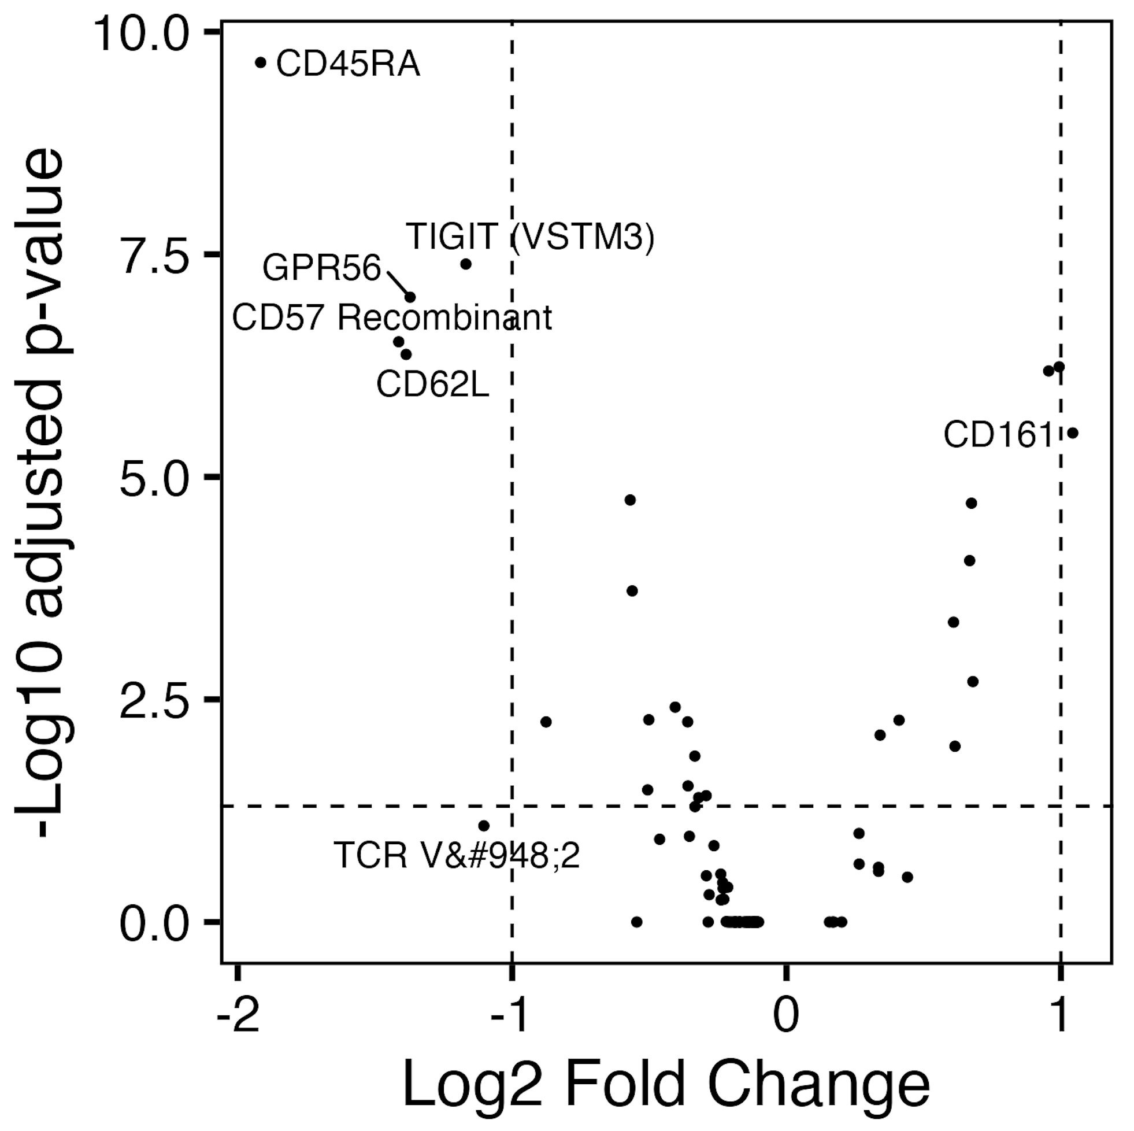
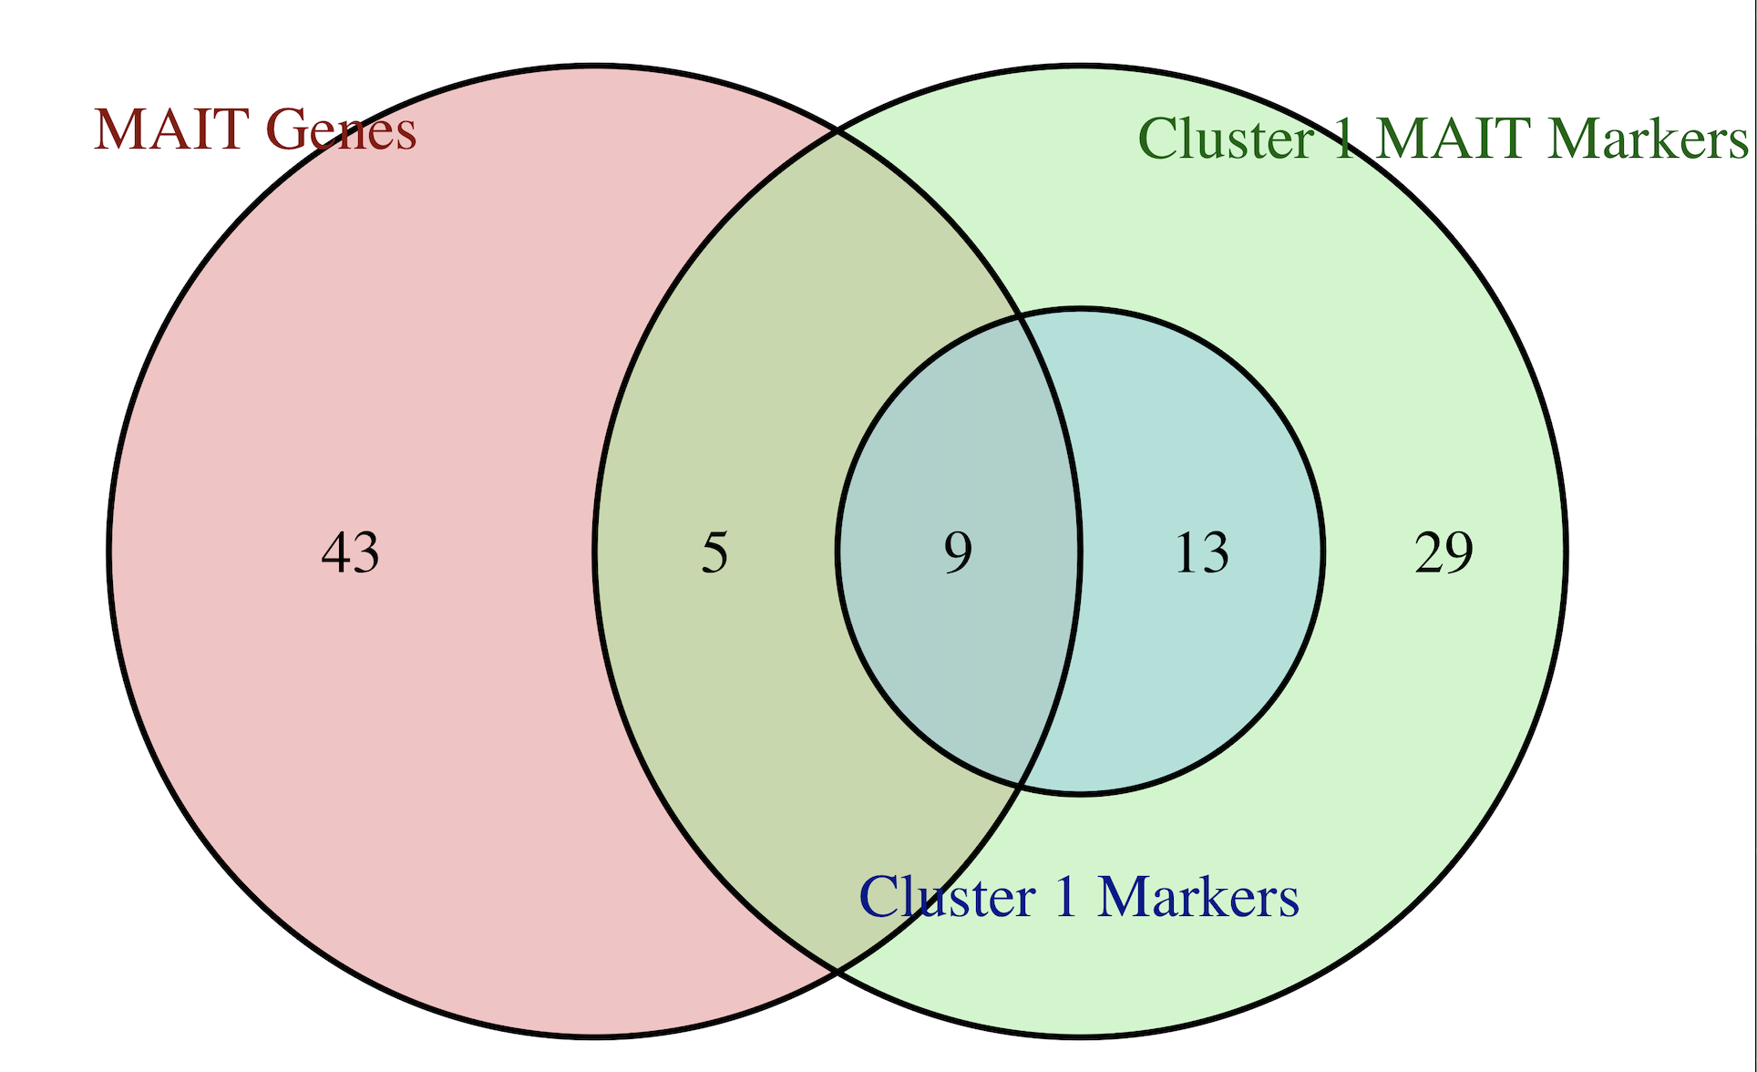
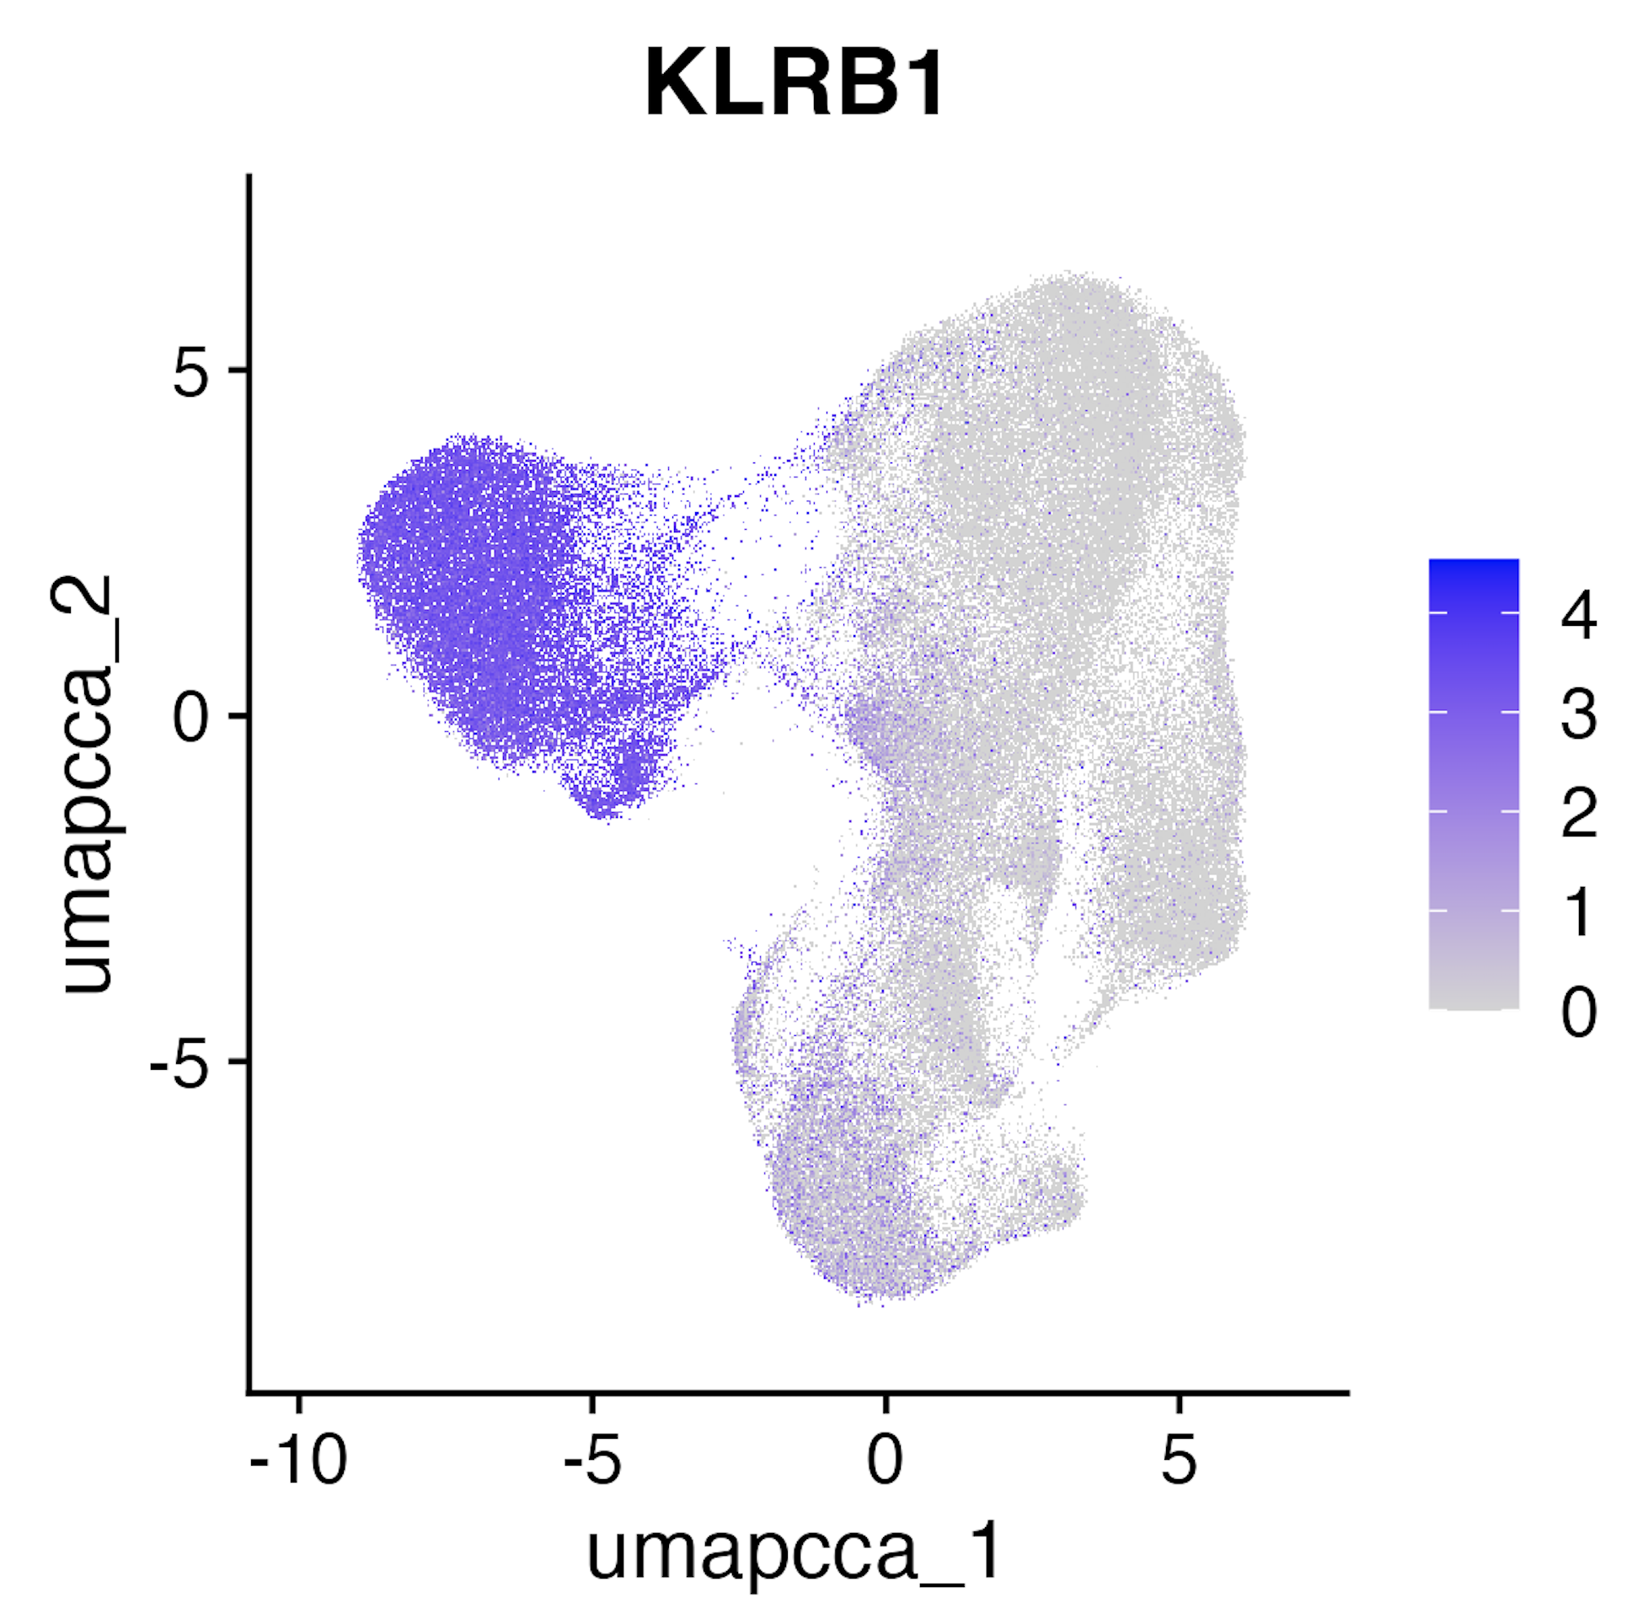
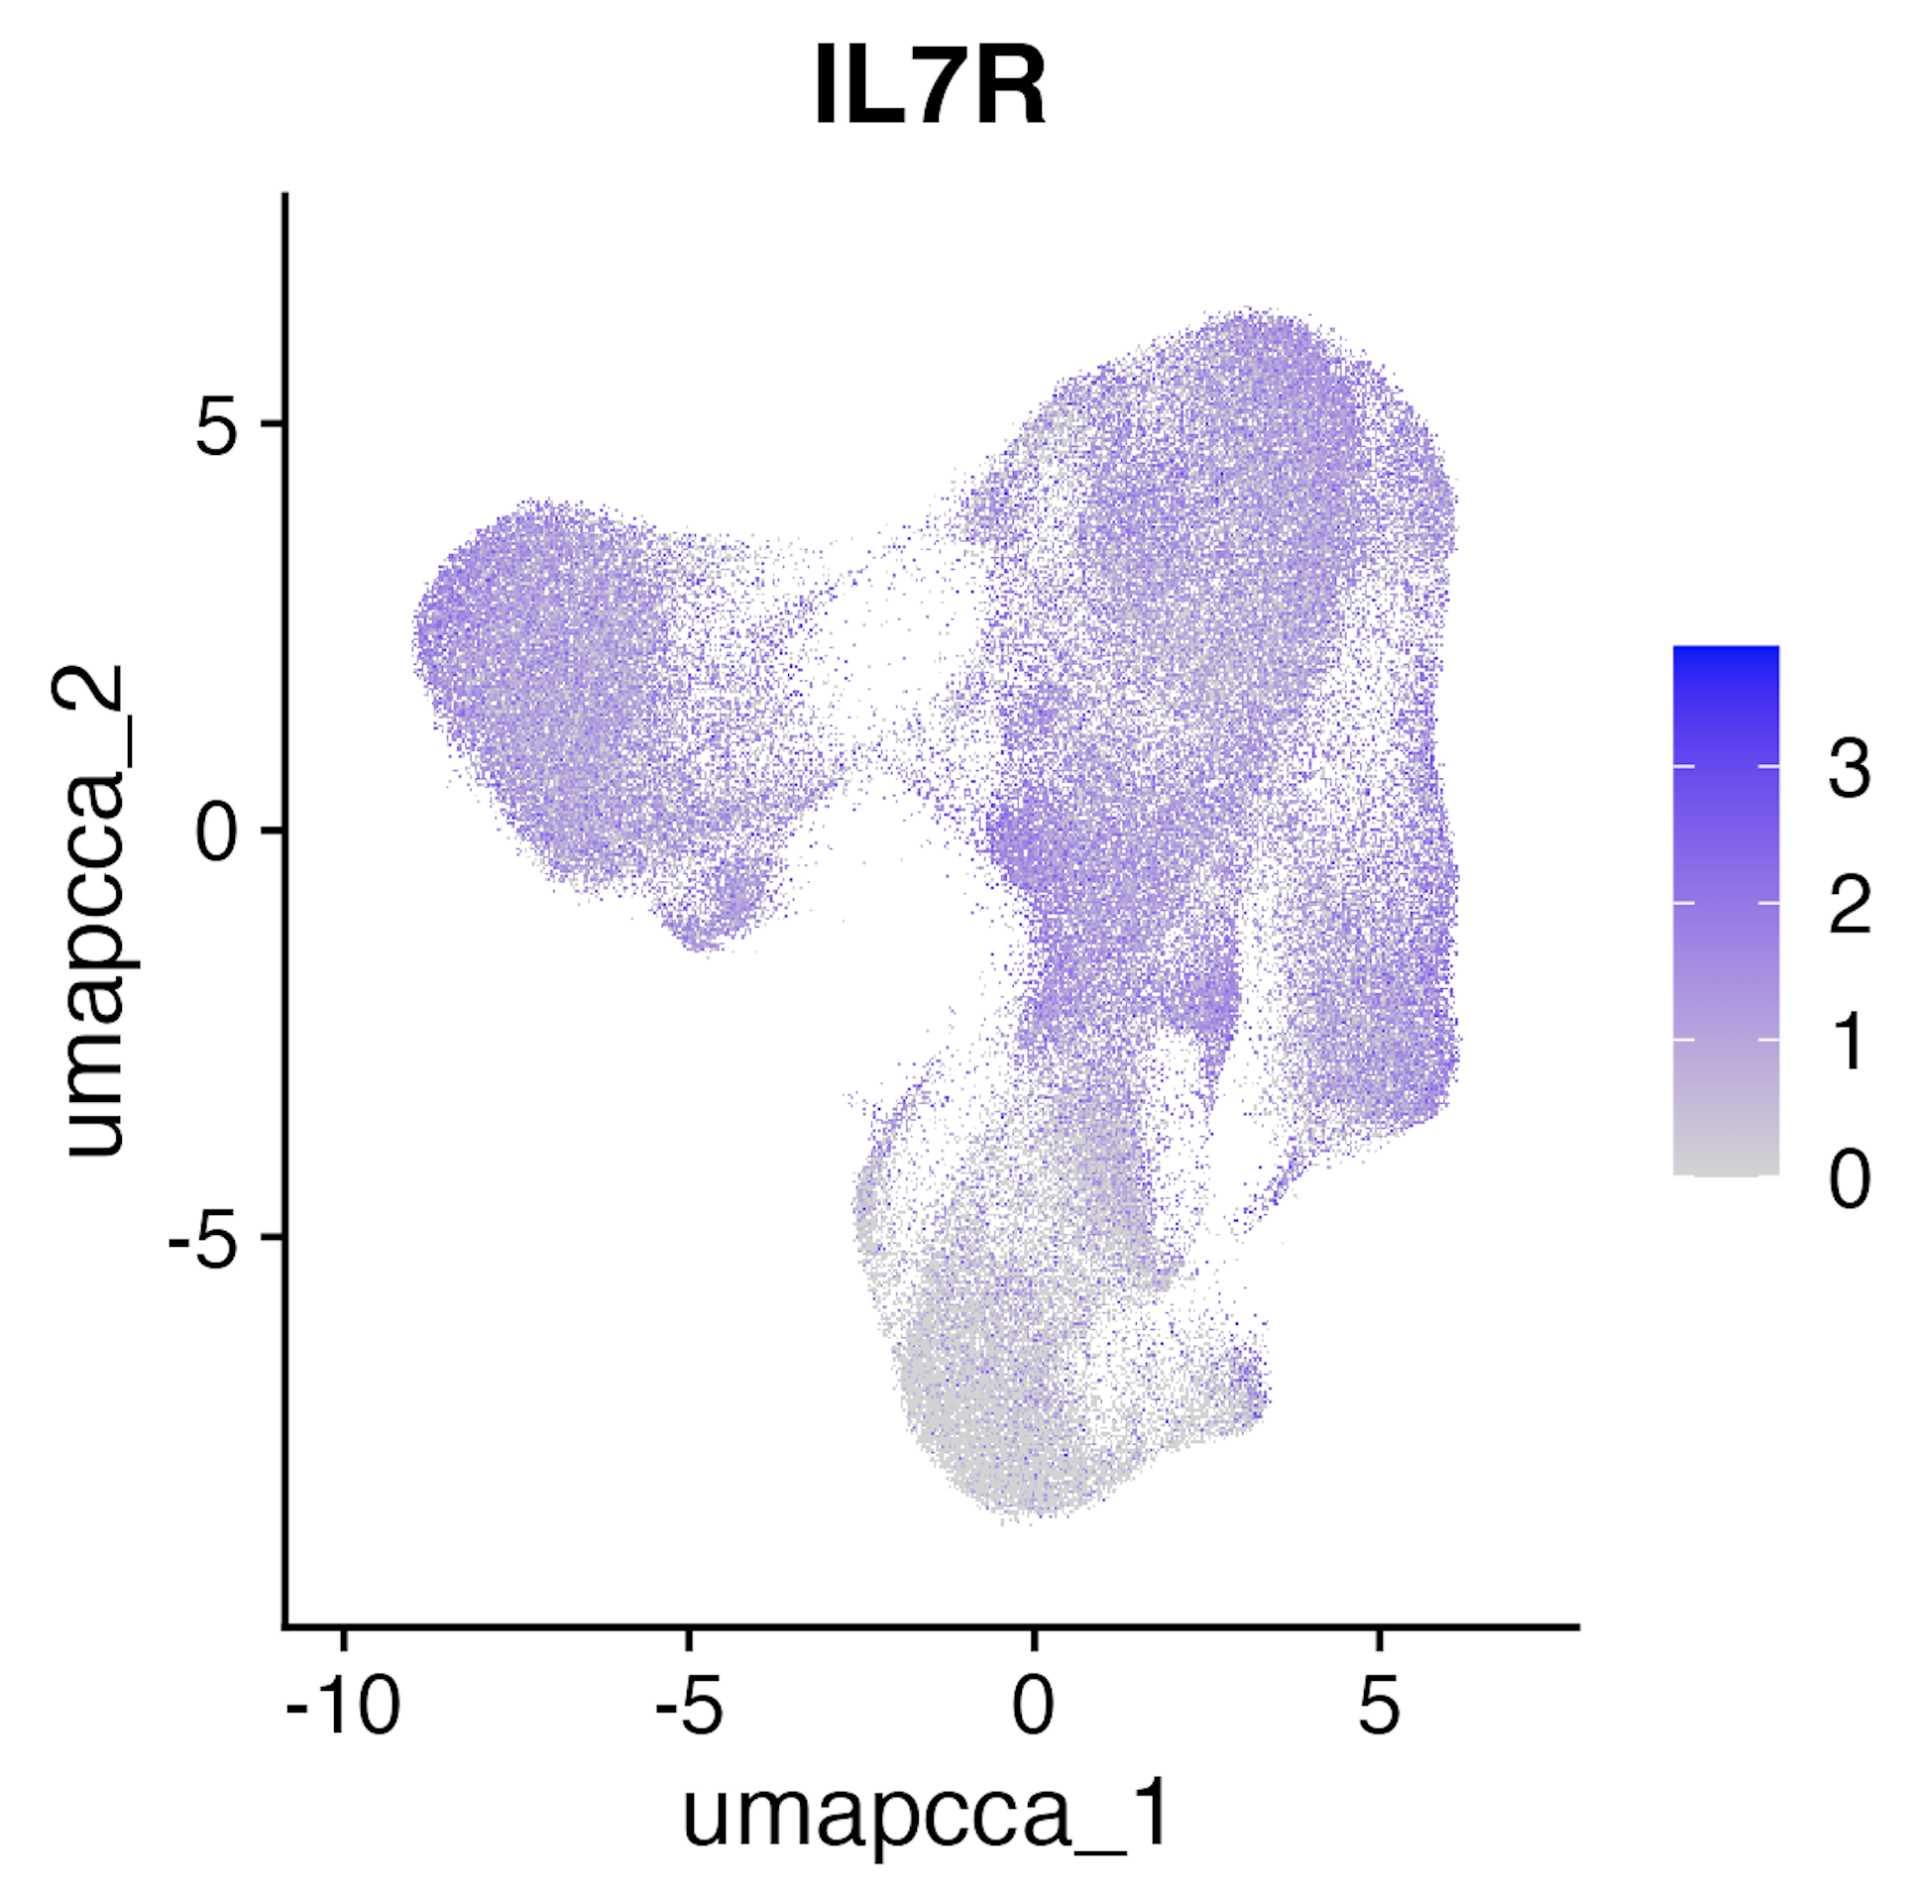
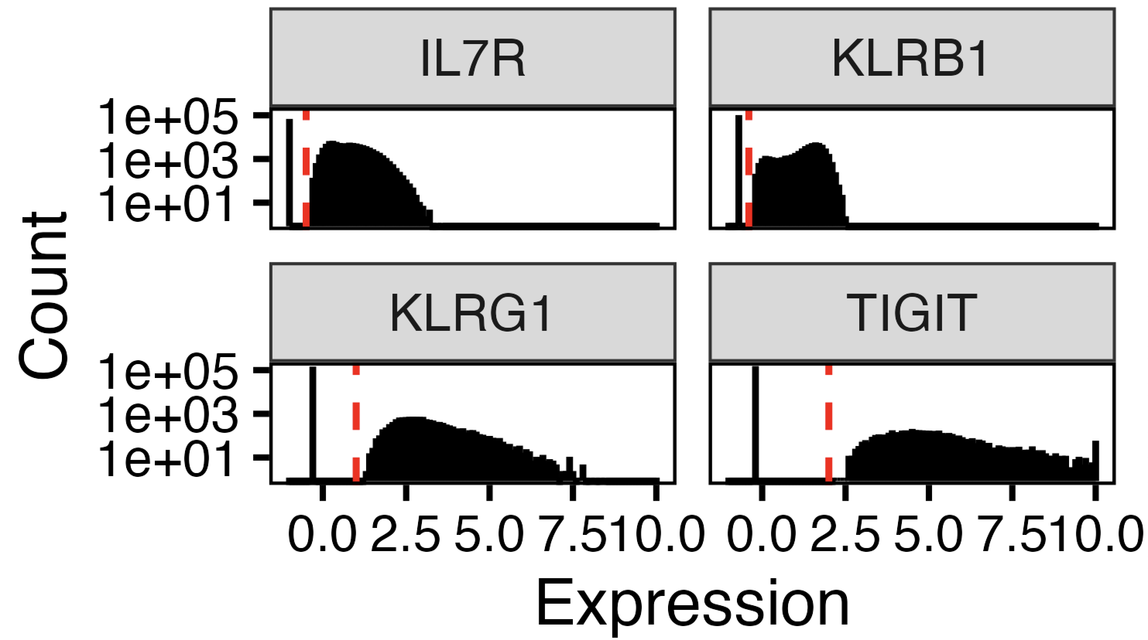
Cluster 1 vs. 4/8 ADT P348-4
P348-2 TN10 cutoffs

